Slide 1
URBANIZATION
Date: 03.11.2022
Teacher: Ms.Krithika

Slide 2
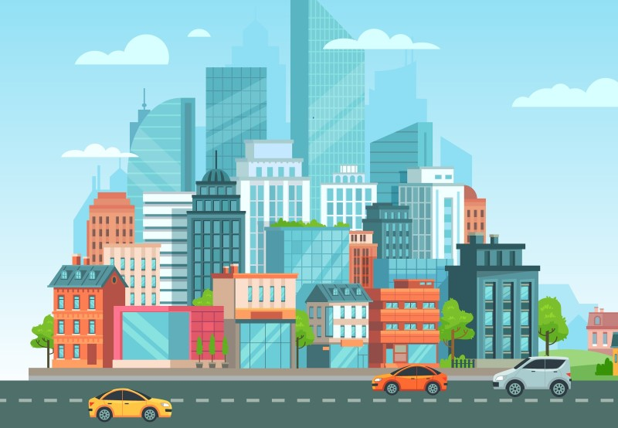
Introduction
Urbanisation is the increase in the proportion of people living in towns and cities. Urbanisation occurs because people move from rural areas (countryside) to urban areas (towns and cities). This usually occurs when a country is still developing.The basic difference between towns and villages is that in towns the main occupation of the people is related to industrial and service sectors, while in the villages most of the people are engaged in primary occupations such as agriculture, fishing, lumbering, mining, animal husbandry, etc. Few settlements reached the population size of more than a few thousand inhabitants. The first urban settlement to reach population of one million was the city of London by around AD 1810 .By 1982 approximately 175 cities in the world had crossed the one million population mark.
Urban Area

Slide 3
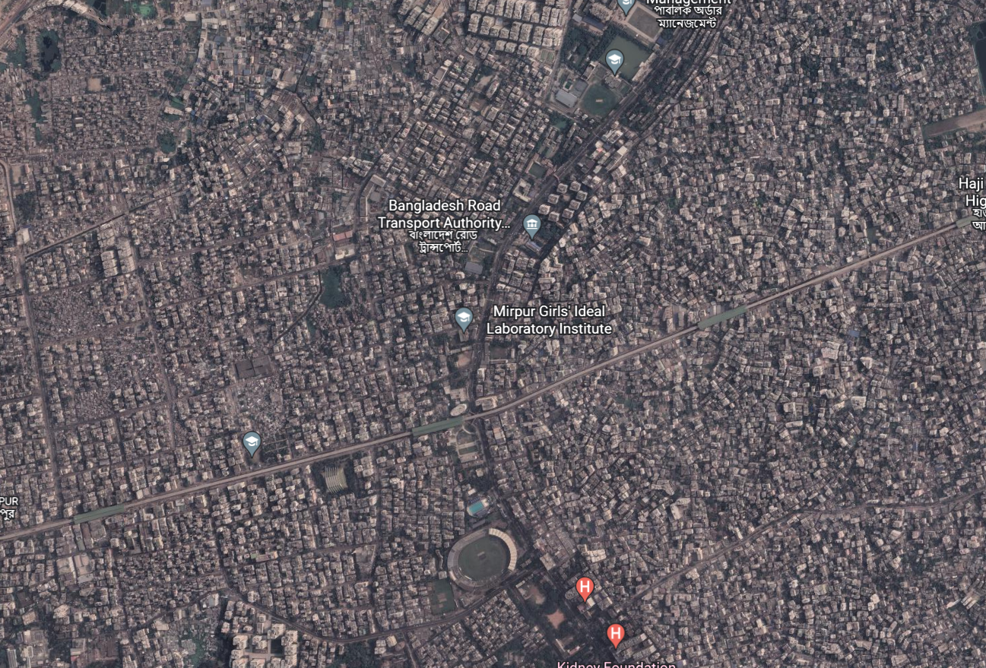
CLASSIFICATION OF URBAN SETTLEMENTS:
The definition of urban areas varies from one country to another. Some of the common basis of classification are size of population, occupational structure and administrative setup. It is an important criteria used by most countries to define urban areas.
The lower limit of the population size for a settlement to be designated as urban is 2,500 in U.S.A. and Thailand, 5,000 in India and 50,000 in Japan. Besides the size of population, density of 400 persons per sq km and share of non-agricultural workers are taken into consideration in India. Countries with low density of population may choose a lower number as the cut-off figure compared to densely populated countries. In Denmark, Sweden and Finland, all places with a population size of 250 persons are called urban.
Most Dense City in the World:
Dhaka, Bangladesh.
23,234 people/sq km

Slide 4



LARGEST CITIES ON EARTH
1) TOKYO
2) DELHI
3) SHANGHAI
Population: 37,468,000
Population: 28,514,000
Population: 25,582,000
Source: UN 2018

Slide 5
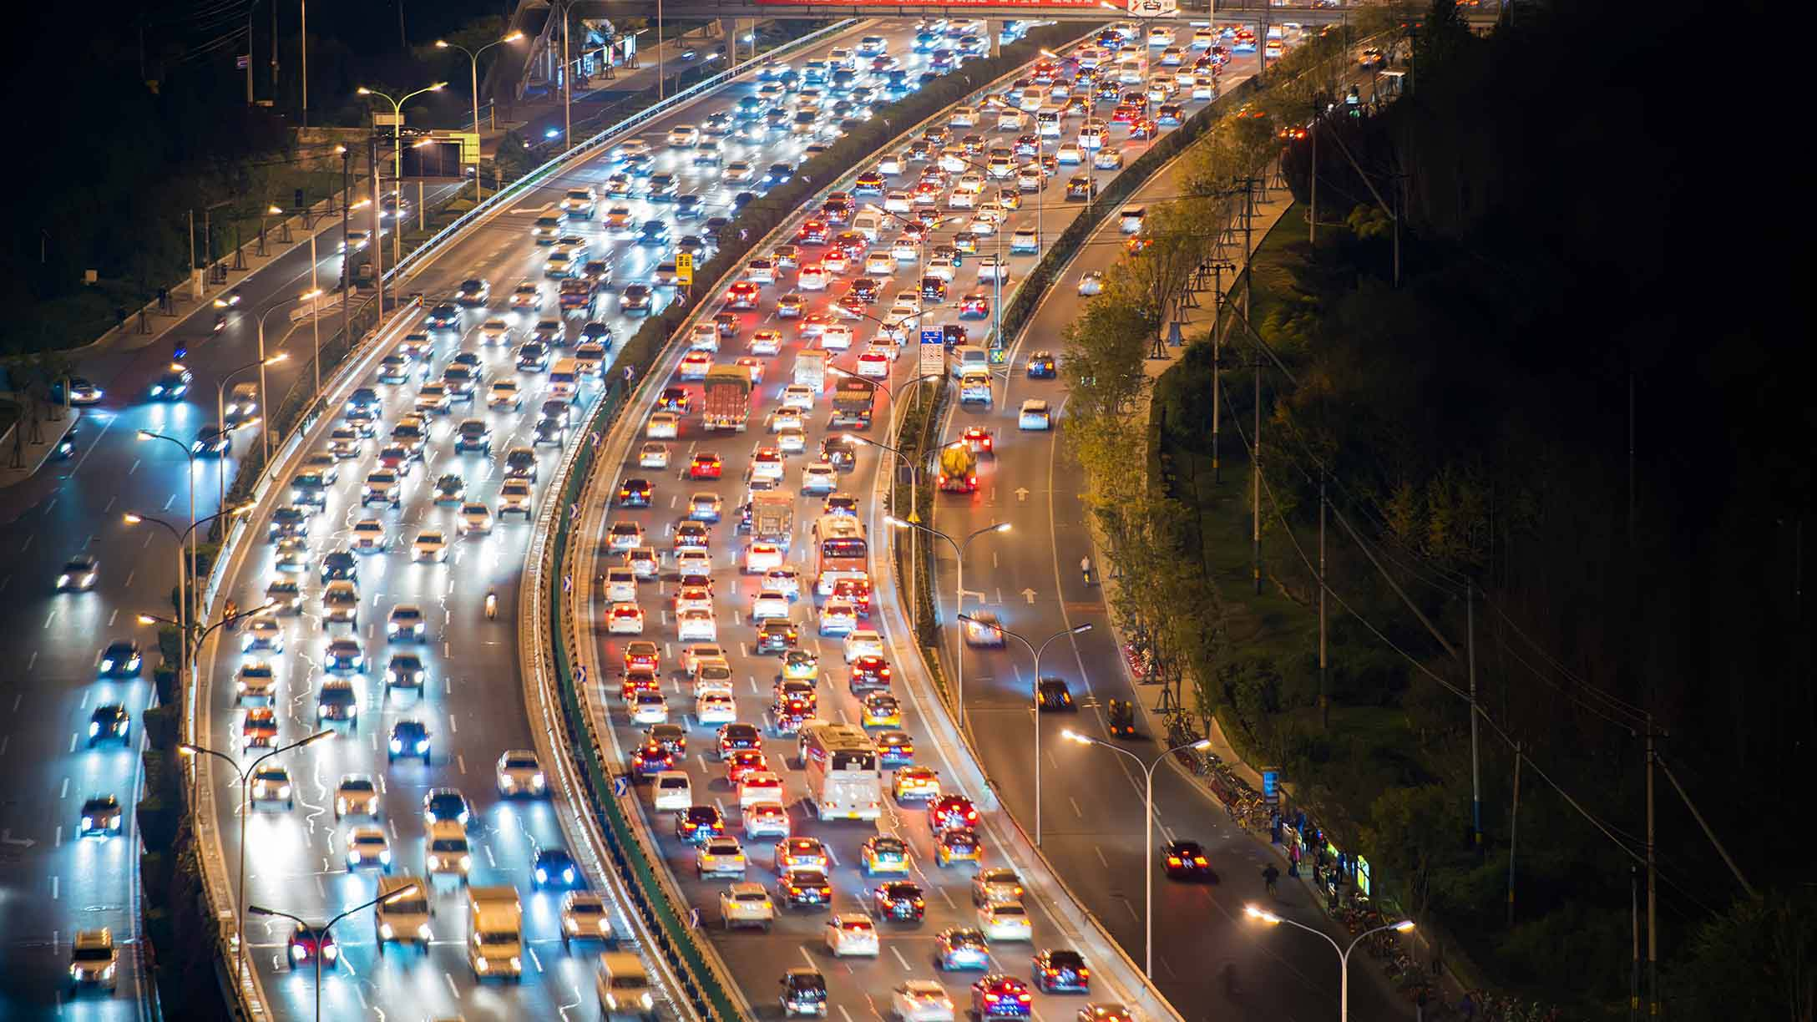
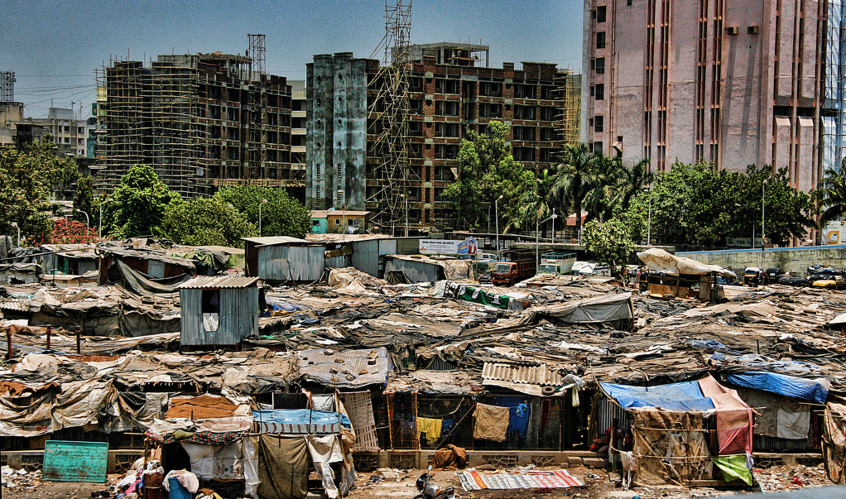
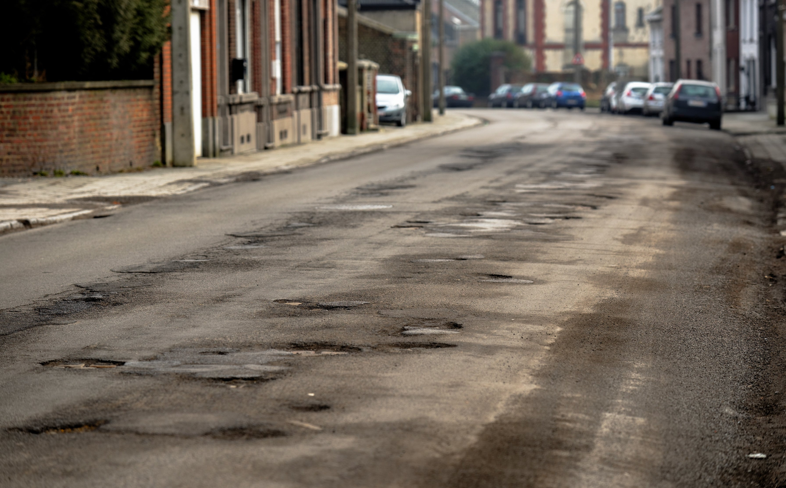
Problems in Urban Areas:
People flock to cities to avail of employment opportunities and civic amenities. Since most cities in developing countries are unplanned, it creates severe congestion. Shortage of housing, unemployment, vertical expansion and growth of slums are characteristic features of modern cities of developing countries. In many cities an increasing proportion of the population lives in substandard housing, e.g. slums.
HIGH POPULATION DENSITY
This problem of high population density is caused due to the heavy rate of migration from rural areas. The rapid population growth has led to an acute shortage of dwelling units which resulted to; overcrowding, traffic congestion, pollution, housing shortages (slums) ,unemployment, and poor sanitation which has become pervasive and indeed high crime rate.
INADEQUATE INFRASTRUCTURES
One major serious aspect of the urban problem is the poor state of the infrastructures. Some developing countries are still faced with bad road network, lack of power supply, inadequate water supply and basic amenities.

Slide 6
—Manmohan Singh
“Urbanization is the inevitable outcome of the processes of growth and the processes of modernization”

Slide 7
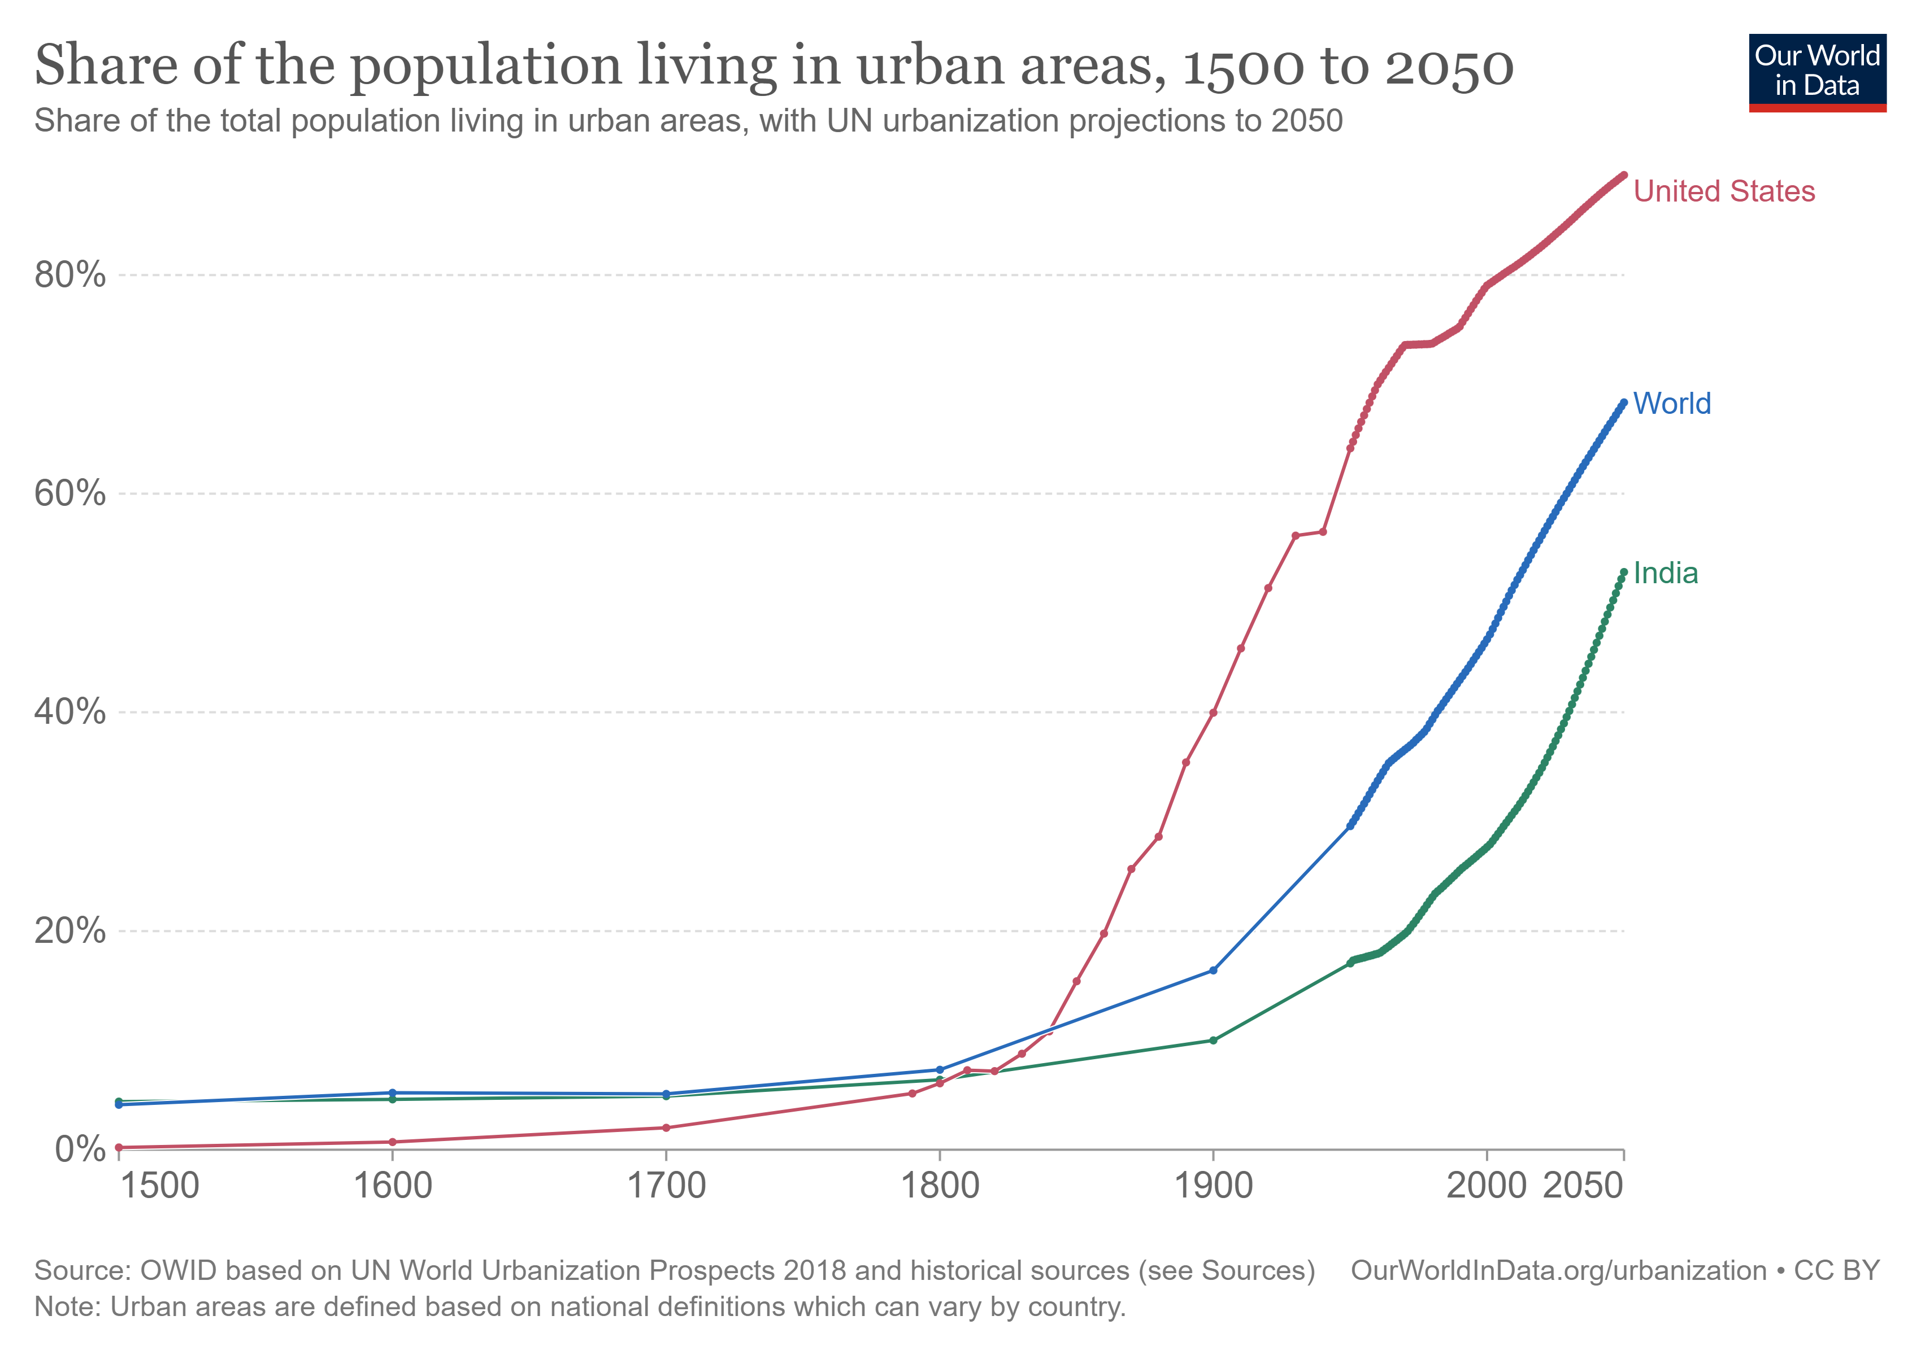
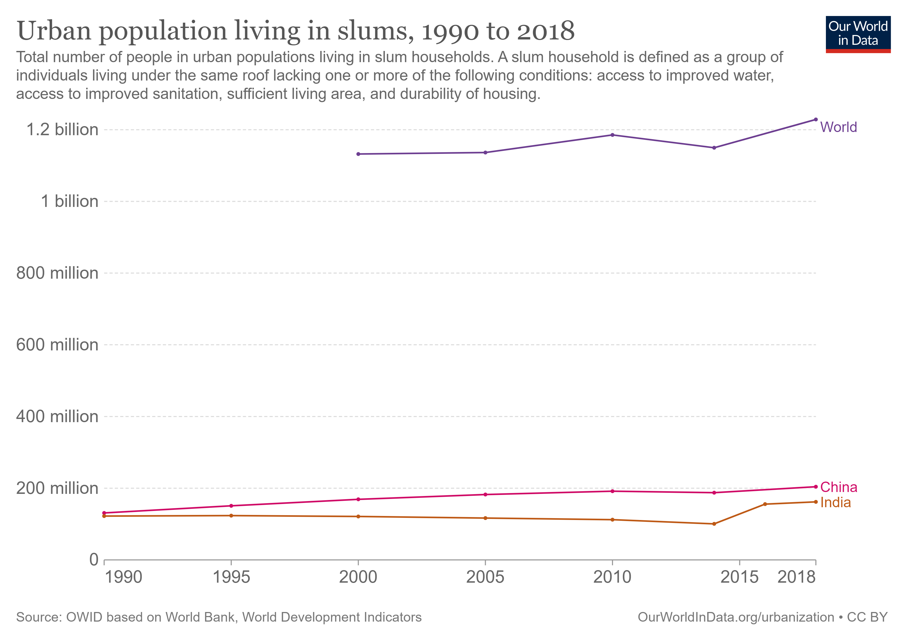
INCREASE IN POPULATION IN URBAN AREAS .

Slide 8


Benefits and Conveniences:
The convenience of goods and services is one of the benefits of urbanization.
There is access to more educational and medical services, which allows increased literacy and better health.
There is also less use of personal vehicles and more availability of public transportation.
There is more social integration in urbanized areas. People of different religions, ethnic backgrounds, social classes and races reside in the same area. This leads to more understanding and acceptance of differences.
Another benefit of urbanization is the possibility of greater earning potential because of the availability of more jobs.

Slide 9
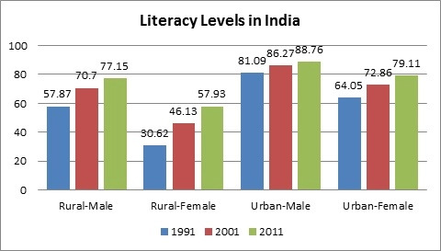
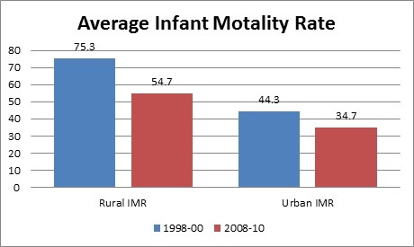
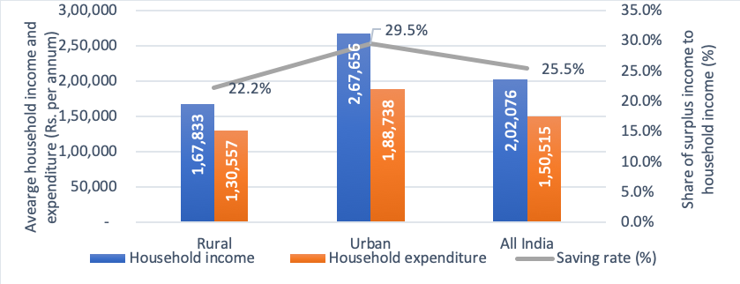
Urban vs Rural: Statistics
Income And Expenditure of Rural and Urban Areas
Infant Mortality Rate in Urban vs Rural Areas
Literacy in Urban vs Rural Areas

Slide 10
Ways to Combat problems of Urban Areas
There are currently 2 ways to minimize the problems of urban areas:
Smart cities
Satellite Cities

Slide 11
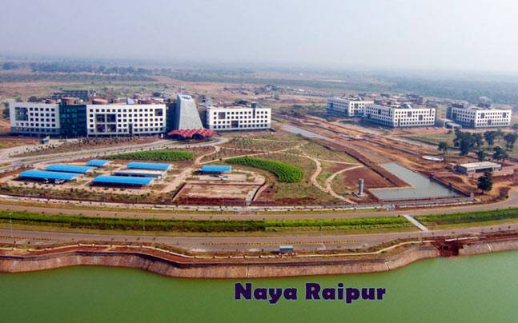
Smart Cities
A smart city is a municipality that uses information and communication technologies to increase operational efficiency, share information with the public and improve both the quality of government services and citizen welfare.
A smart city is a developed urban area that creates sustainable economic development and high quality of life by excelling in multiple key areas; economy, mobility, environment, people, living, and government.
Example: Singapore,Helsinki,Geneva.
In India : Coimbatore,Amritsar,Naya Raipur
A Smart City in India

Slide 12
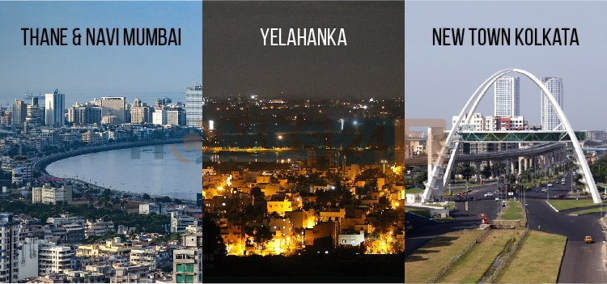
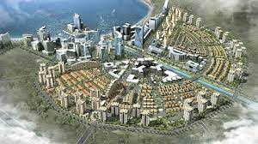
Satellite Cities
The satellite city is one of the popular concepts in the urban planning.
It is the small metropolitan area is located near to the large metropolitan area.
The satellite town provides the best solution to the problems of urbanisation.
These satellite cities reduce the infrastructural strain on the main city
They are loaded with huge range of the amenities such as school, hospital, shopping center and others
In India : Yelahanka New town,Thane , Navi Mumbai

Slide 13
THANKS
Does anyone have any questions?
Team:
Abishek (LEADER)
Aditya Raj
Anshika
Bernice
Chirag

